Slide 1
Using PostGIS with Javascript
How to enable geographics in your Javascript app.

Slide 2
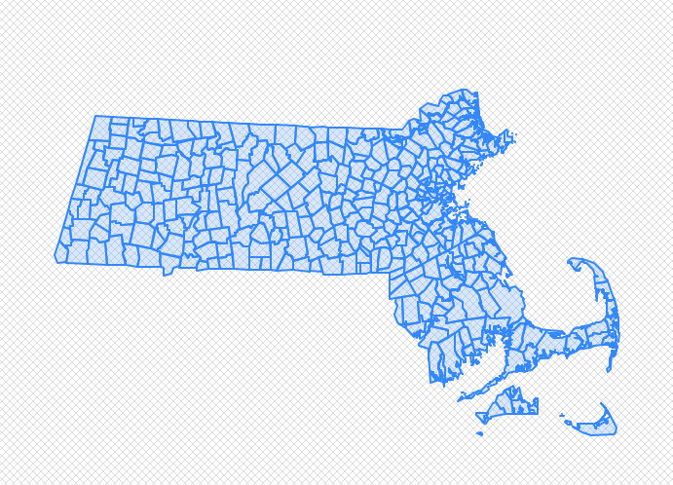
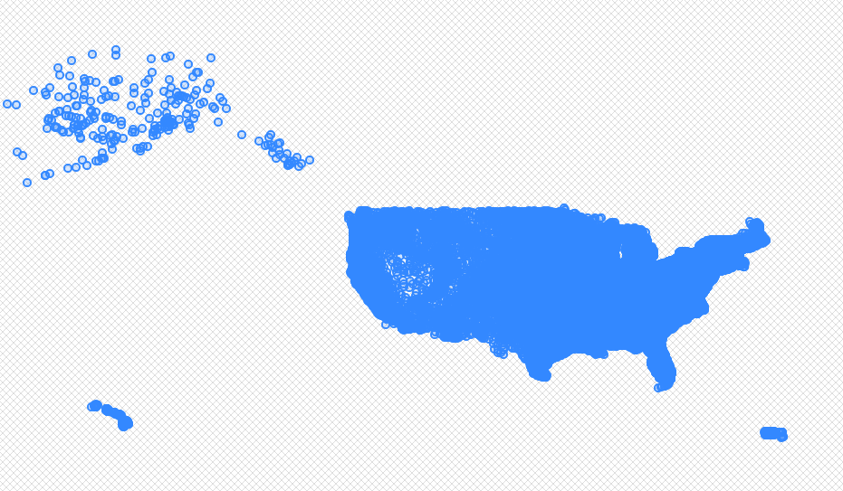
Steps to Success
Install and enable PostGIS on PostgreSQL
Build geographic data structures
Locate suitable sample data
Seed postGIS with sample data
Perform geographic operations
Display results

Slide 3
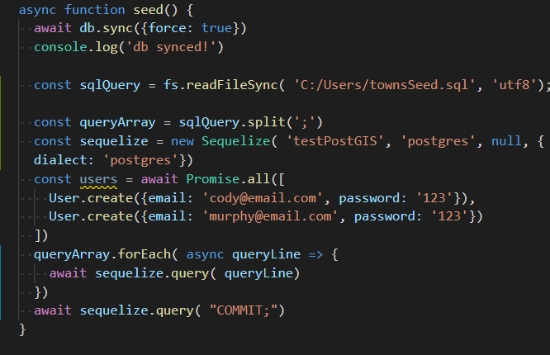
Issues Encountered
Loading data
Projections
Spatial Indexes
Sequelize limitiations

Slide 4
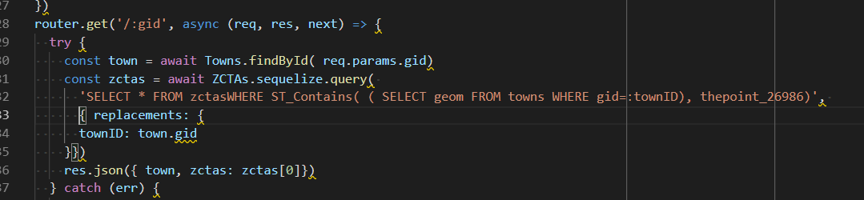
Accomplishments
Installed and enabled PostGIS
Loaded Massachusetts town boundaries and Zip Code Tabulation Areas
Built a simple geographic query to find Zip Code Tabluation Areas inside of a town boundary.
Developed a simple user interface

